Slide 1
WELCOME TO
HIT
Holon Institute of Technology

Slide 2
1969
A premiere academic institution of higher education in engineering, science, design and technology was established in Holon.

Slide 3
Which was later
to become…
THE
H
OLON
I
NSTITUTE OF
T
ECHNOLOGY

Slide 4
HIT's DNA
Applied Research
Finding practical solutions to
real problems
Entrepreneurship
Helping students and faculty translate ideas into business opportunities
Innovation
Creating eco-systems which encourage novel ideas that are ‘out-of-the-box’
Multidisciplinary
Cross-fertilization of ideas across
5 Faculties, 1 School and 2 Departments
Academy-Industry Engagement
Ensuring that curriculum and research
address industry needs and opportunities
Social Impact
Technology in the service of
humanity in order to improve lives

Slide 5
8 Major
Academic Units
Electric
& Electronics
Engineering
Sciences
Design
Industrial Engineering
& Technology Management
Instructional Technologies
Digital Medical Technologies
Data Science
The School of Multidisciplinary Studies

Slide 6
Founded
in 1969
8 major academic units
School – Multi-
Disciplinary
Studies
Over 130 International
Academic Partners from 35 countries
Over 17,000
Alumni
60 Research
Centers
5,000
students
Unique Instructional Technologies
Faculty
Unique Digital Medical Technologies Department

Slide 7
Academics Programs
Engineering
Science
Design
Industrial Engineering& Technology Management
Instructional Technologies
Digital Medical Technologies
Data Science
B.Sc.
B.Sc.
B.Des.
B.Sc.
B.A.
B.Sc.
Electric & Electronics Engineering
Computer
Science
Applied Mathematics
Industrial Design
Interior Design
Visual Communication Design
Industrial Engineering & Technology Management
Technology Management
Instructional Technologies
Digital Medical Technologies
Direct M.Sc
Direct M.Sc
Direct M.Sc
Direct M.A.
M.Sc.
M.Sc.
M.Sc.
M.A.
M.Sc.
Electrical & Electronics Engineering
Computer Science
Technology
Management
Instructional
Technologies
Data Science

Slide 8
We make higher education accessible to all strata of the population in 374 cities, towns and villages across Israel
Our students are committed to community service and social action

Slide 9
150
Senior Faculty Members
45
Professors
Gathered from the best institutions
And the most dynamic industries
from Israel and abroad

Slide 10
Green Campus
(540,000 sq.ft.)
50,000 sq.m
In the center of Israel

Slide 11
A new building for Medical
Technology and Innovation
(to be completed Fall 2024)
3 new Dormitory Buildings
Plans that become reality

Slide 12
We pursue research and development
across the board
Create centers of excellence
Digital Medical Technologies Centers, Multidisciplinary R&D Centers, Intradisciplinary R&D Centers
Offer seed funds for young researchers, internal incentive scholarships
Forge joint research initiatives collaborating with both Israeli and international universities
Provide grant management and oversight services
Strengthen research encourage grant submission, research skill workshops, international consortia
Establish accelerators & incubators
Future HIT and Handzone
Engage government agencies in national and ministerial funding initiatives

Slide 13
International Conferences
International Student Exchange
Academic Partnerships
Capacity Building & Mobility
Internationalization

Slide 14
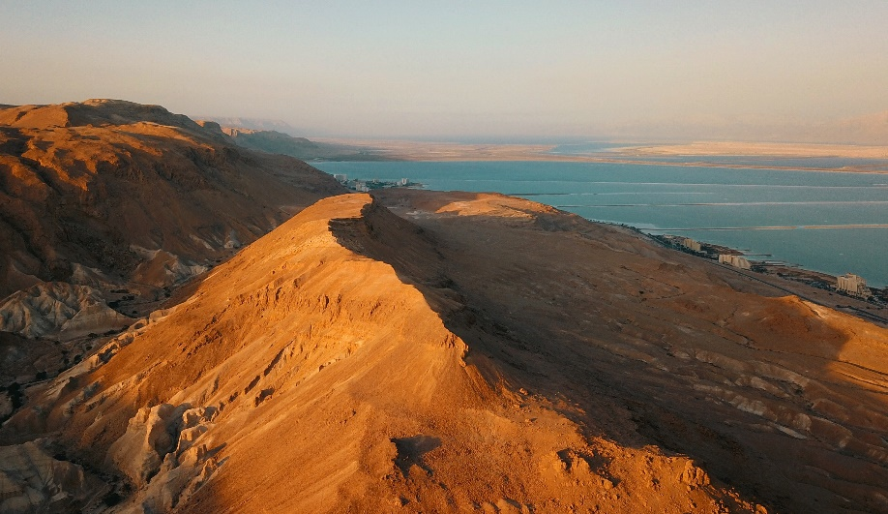
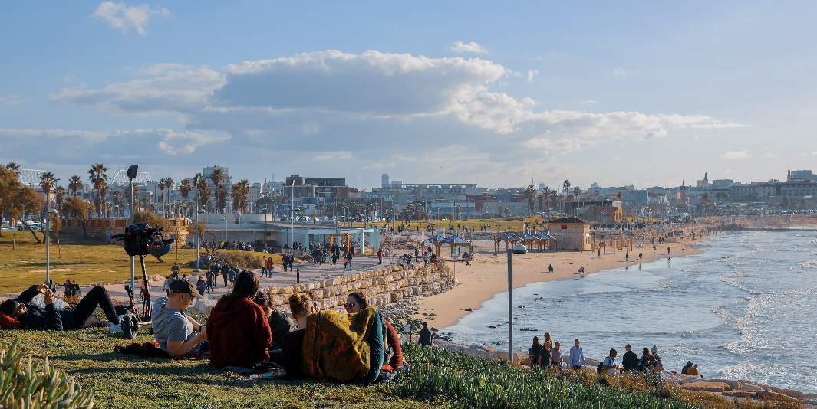
Tel Aviv beach
Dad sea
Tel Aviv
Jerusalem
Israel views

Slide 15
Thank you!

Slide 16
The Faculty of Instructional Technologies
Goal: to support and promote the effective exploitation of digital technologies for training and learning in diverse organizations
BA Degree: academic foundation and applied skills for planning, designing, and developing digital learning solutions
MA Degree: management and implementation of learning & technology for professionals in the field
Integrated BA/MA program: allows outstanding undergraduate students to simultaneously acquire B.A. & M.A. degrees.
Faculty includes senior academic staff alongside industry experts.

Slide 17
Our most innovative program
Digital medical technologies
Creating a new generation of technologically- savvy physicians and health analysts
Innovative and Unique – the only B.Sc program of its kind in Israel and around the world
3 year program – 2 years basic medical and data science; 3rd year choice of specializati
Two specialization tracks - Pre-med and Information Technology
Final Project – hands-on engagement with medical and health-tech entities
3 major laboratories: Living Lab; Medical Assistive Device Lab (MADE); Health x x (HEAL)
Possibility of continuing to M.Sc in Data Science: Medical Health Systems Track
R&D – clinical research projects with 8 major medical centers and 2 HMO’s

Slide 18
The Faculty of Multidisciplinary Studies
The school of Multidisciplinary Studies is an academic melting pot in which all undergraduate students at HIT attend.
It is the only academic entity of its kind in Israel, committed to advancing multidisciplinary activities in Israel and around the globe and encourages sharing knowledge and best practices, fostering cooperation and mutual learning, enhancing relations with industry and strengthening international skills and interactions Promoting out-of-the box creative thinking
School courses are given in four clusters:
Humanities and social sciences,
Technology integrated courses,
Social intervention project
Entrepreneurship and innovation.

Slide 19
The Faculty of DESIGN
Largest design faculty in the State of Israel, with xxx students and xxx faculty members from academe and professional practice
Visual Communication
Industrial
Interior
3 departments:
Formula for success:
Pluralistic approach - Design BY the people FOR the people, from conceptual to technogical, artistic to corporate, design ‘making’ to applied
Multidisciplinary – drawing on ideals and expertise from different fields of knowledge
Individualistic design as an act of social consideration and involvement
Ongoing adaptation to updated technologies, changing human needs and evolving world order
Workshops and labs allow for experimentation and application of ideas

Slide 20
The Faculty of Sciences
VISION
Academic hub of excellence in exact sciences
Create, experiment and disseminate ideas and knowledge
MISSION
Innovative teaching
High level basic and applied research for industry advancement
Forging of next generation of science leaders and creators
PROGRAMS
Computer Science - B.Sc and M.Sc (with and without thesis) – largest department on campus
Applied Mathematics – B.Sc
RESEARCH
Highest percentage of competitive research grants at HIT
Active participation in international and local conferences
Publications in top-notch journals

